Slide 1


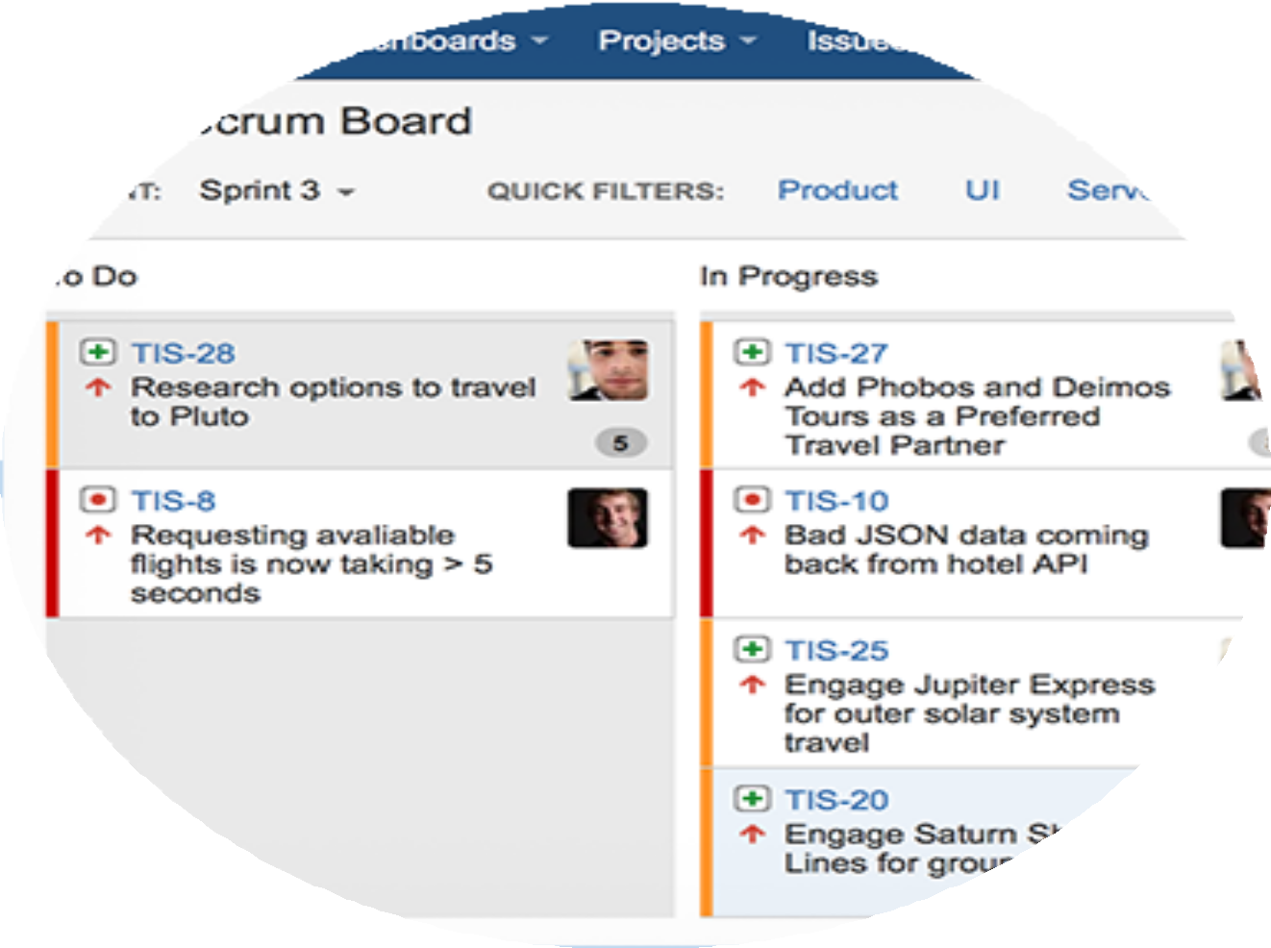



101
Dan Chuparkoff
@chuparkoff

Slide 2
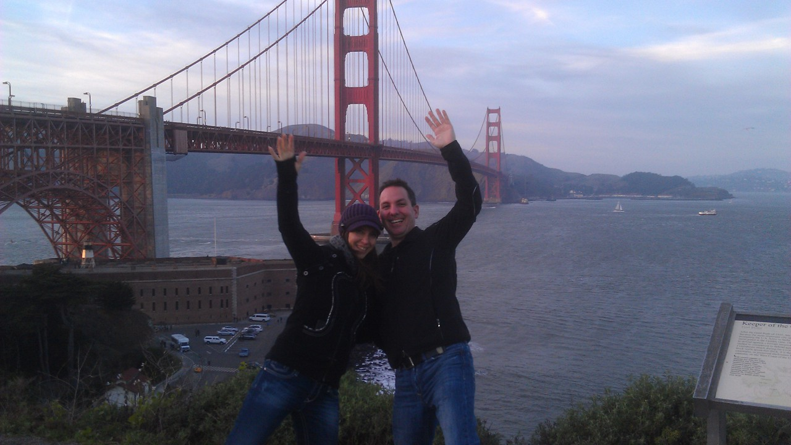

Dan Chuparkoff
Group Manager, JIRA Family
Learning JIRA with @chuparkoff at @atlassian

Slide 3

Track
ALL THE THINGS!!!

Slide 4

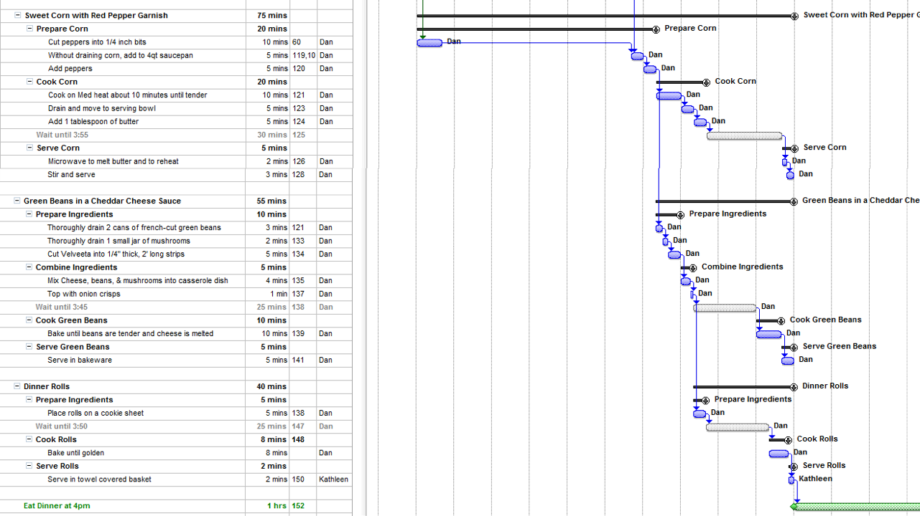



Slide 5
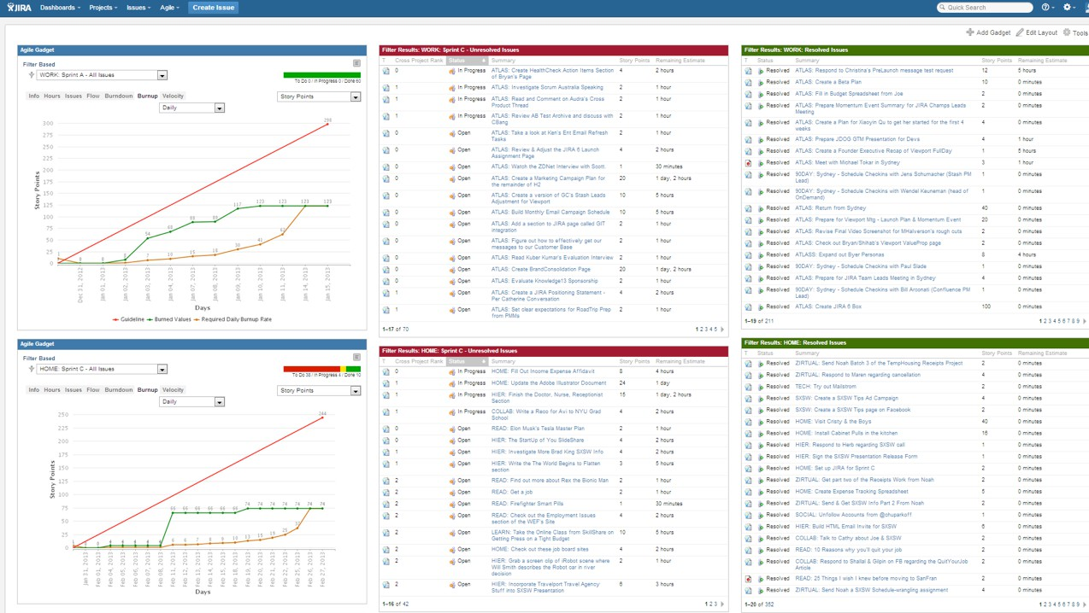

Slide 6



Intro to Agile Concepts
JIRA Agile Plan,Work,Track
101
JIRA Issues & Dashboards
JIRA Administration

Slide 7
Intro to Agile Concepts
JIRA Agile Plan,Work,Track
101
JIRA Issues & Dashboards

Slide 8
Agile
better visibility
better prioritization
Why
less downtime btw tasks
improved teamwork
more predictability

Slide 9
Creating tasks

Slide 10
Challenge 1: What’s a Task?
Doing a case study ???
Making a promo video ???
Doing market research ???

Slide 11


Challenge 1: What’s a Task?
More than 30 minutes
but
Less than 3 days

Slide 12

Challenge 2: But I’m waiting
My ‘Write a blog’ task takes longer than 3 days because I have to wait for people to review it.
Write a blog

Slide 13


Challenge 2: But I’m Waiting…
Waiting is a good sign that your task is really 3 tasks.
Write a blog draft
Review blog draft
Revise blog draft

Slide 14
Challenge 3: How Long Will It Take?
Estimating is hard
Use story points
1, 2, 4, 8, 16, 32, 48

Slide 15





Story point ‘cheating’
30 mins = 1 story point
1 hour = 2 story points
2 hours = 4 story points
4 hours = 8 story points
day
days
days
= 16 story points
= 32 story points
= 48 story points

Slide 16
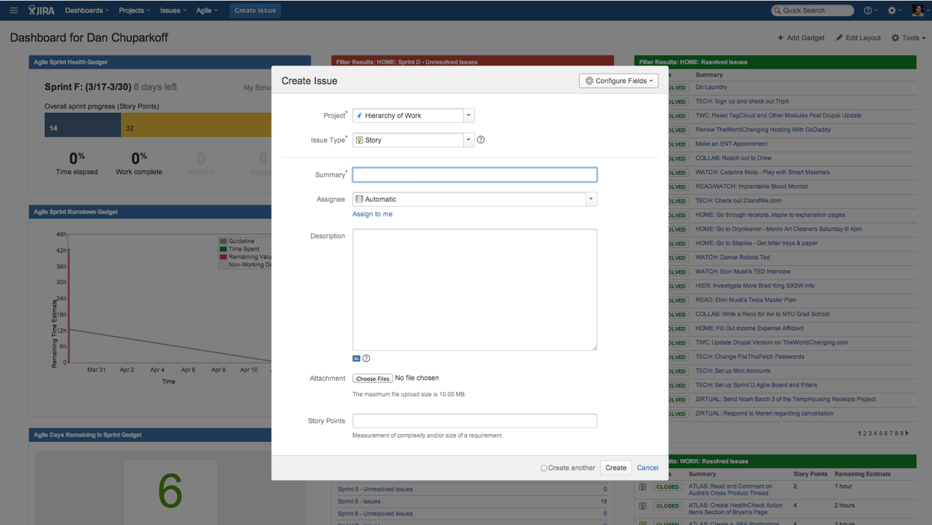
Creating tasks

Slide 17
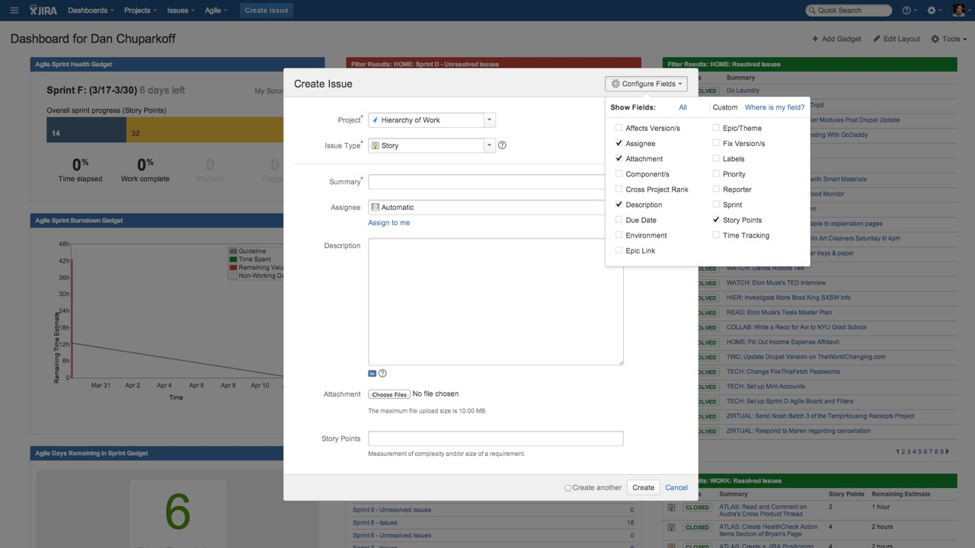

Slide 18
http://extranet.atlassian.com/jira
(‘eee-aay-cee-jay’)

Slide 19
Scrum vs Kanban

Slide 20
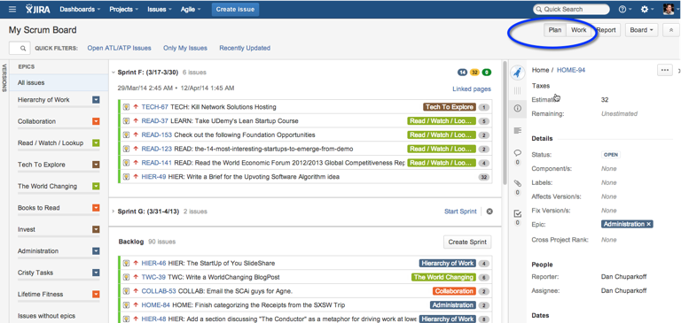
Scrum
Teams with target deadlines.
Organize your prioritized list in batches called Sprints

Slide 21
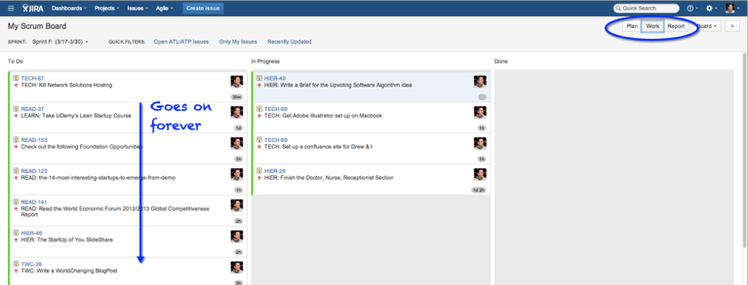
Kanban
Support and service teams.
Work from a prioritized list as fast as you can.
No Plan mode, no Sprints

Slide 22
Intro to Agile Concepts
JIRA Agile Plan,Work,Track
101
JIRA Issues & Dashboards

Slide 23
Plan mode

Slide 24
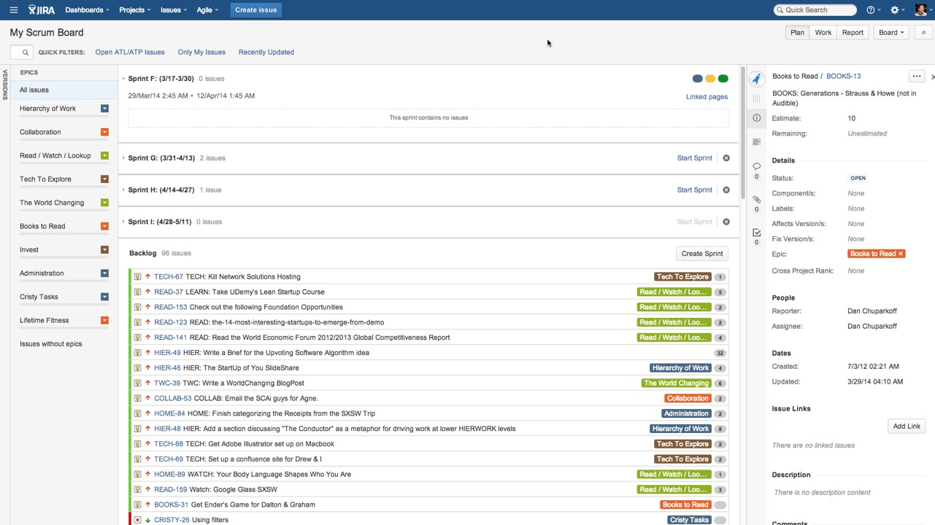
What is a task?

Slide 25
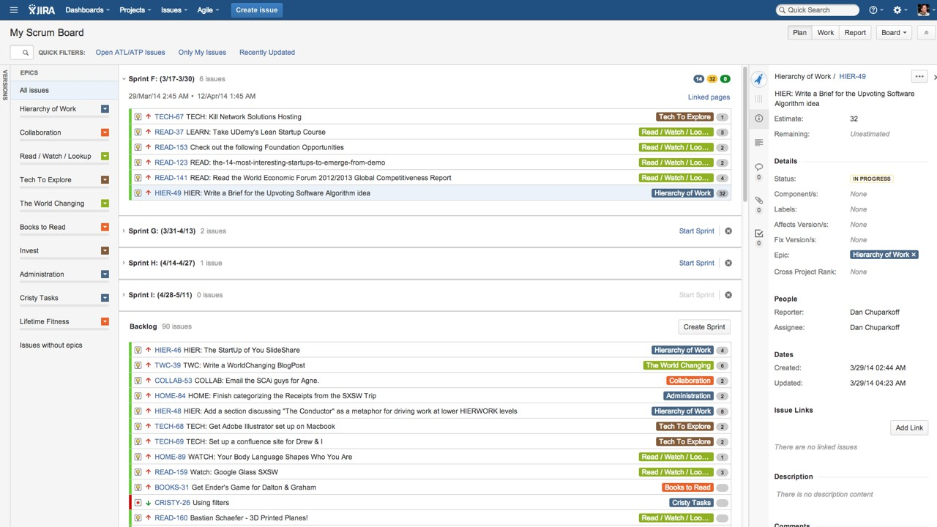
What is a task?

Slide 26
Work mode

Slide 27
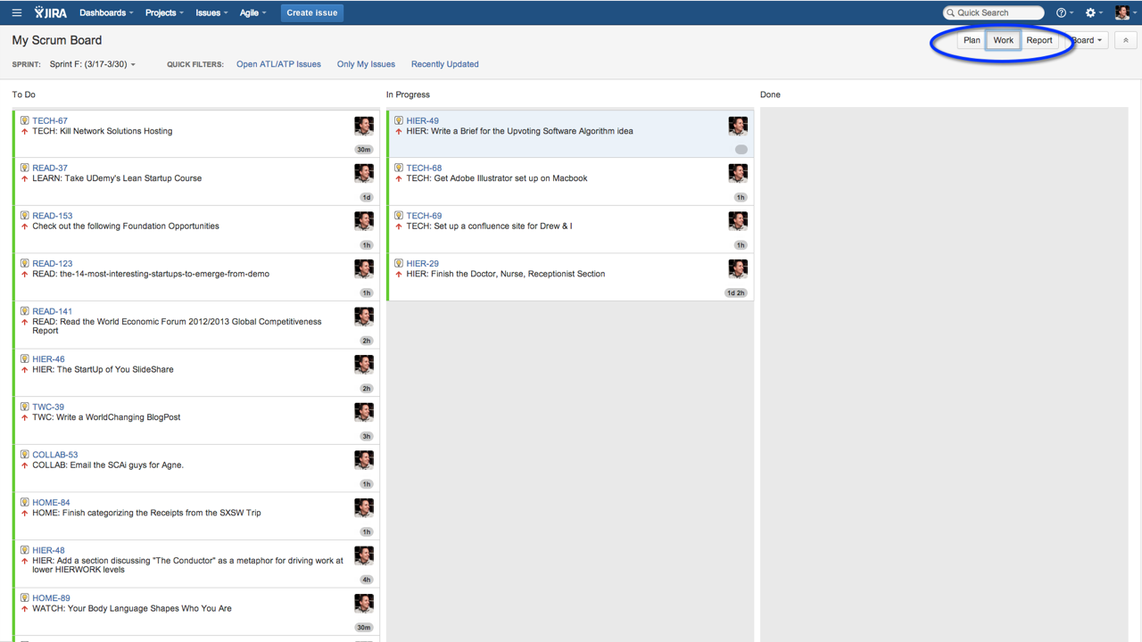
Work mode

Slide 28
Burndown

Slide 29
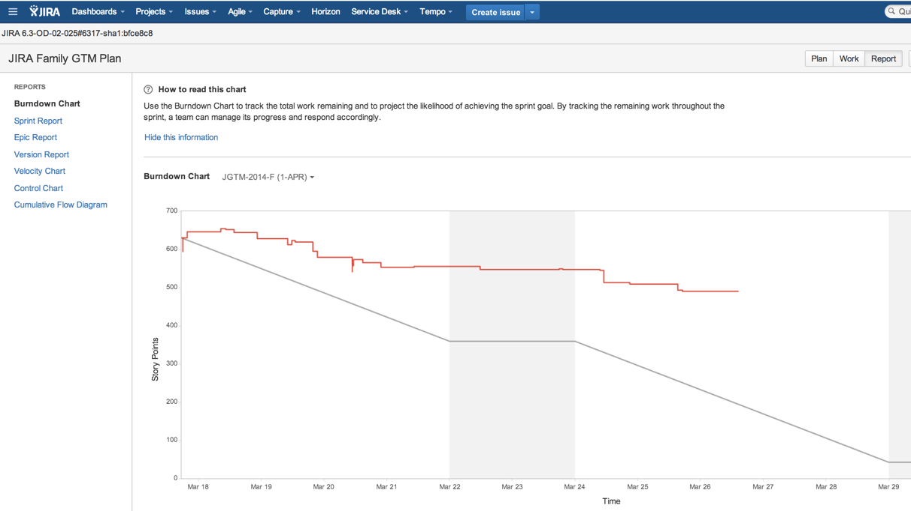

Slide 30
Intro to Agile Concepts
JIRA Agile Plan,Work,Track
101
JIRA Issues & Dashboards

Slide 31
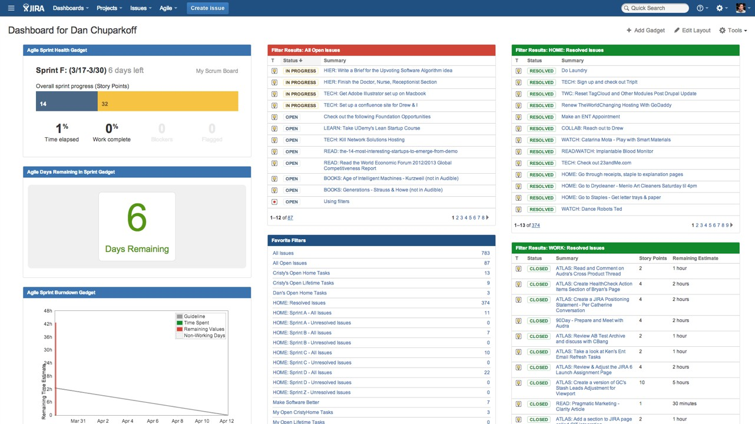

Slide 32


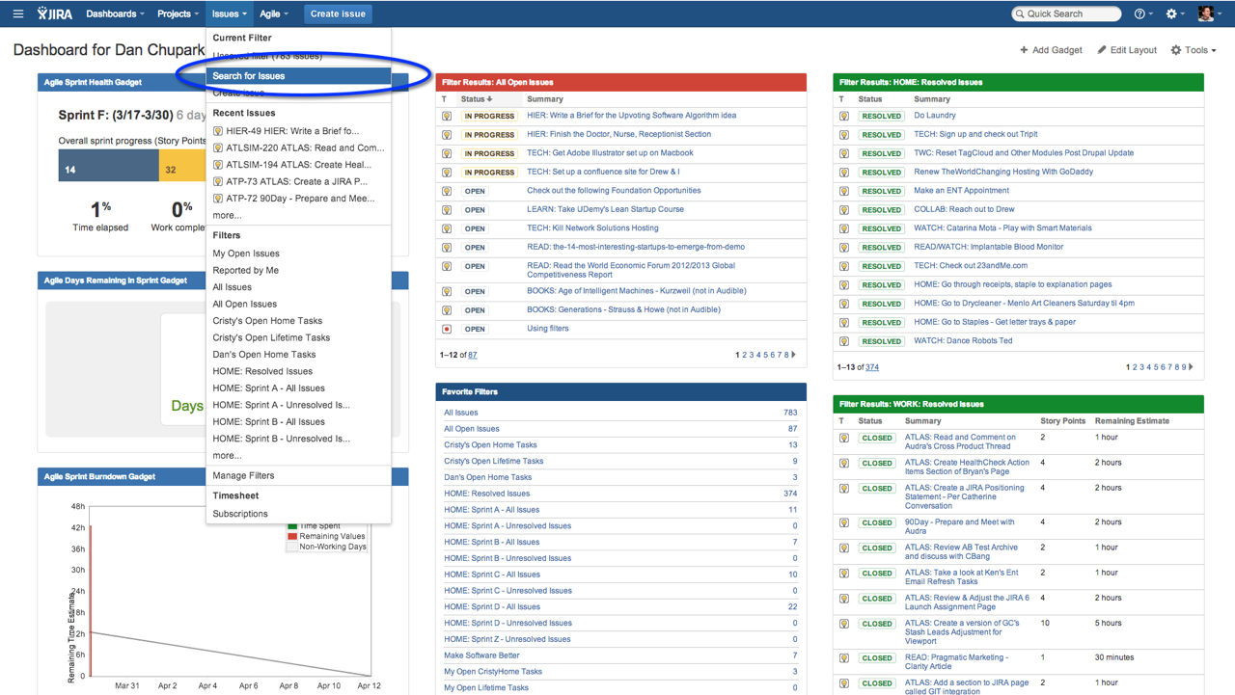


Slide 33
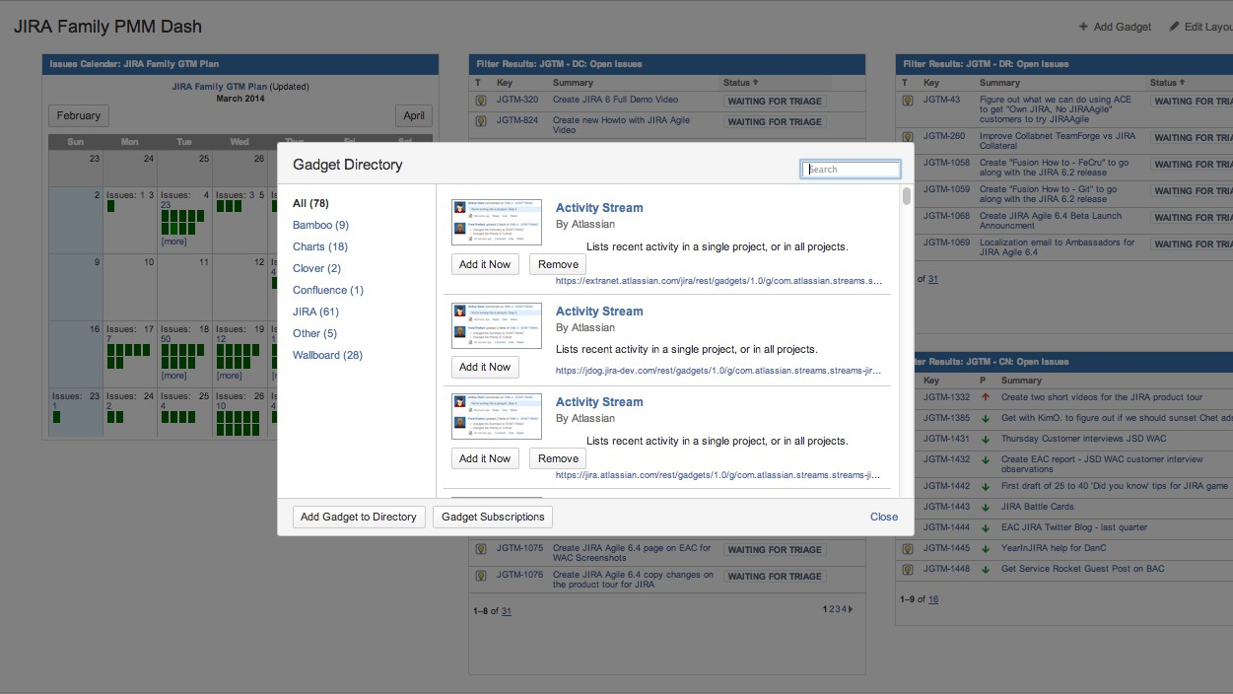

Slide 34

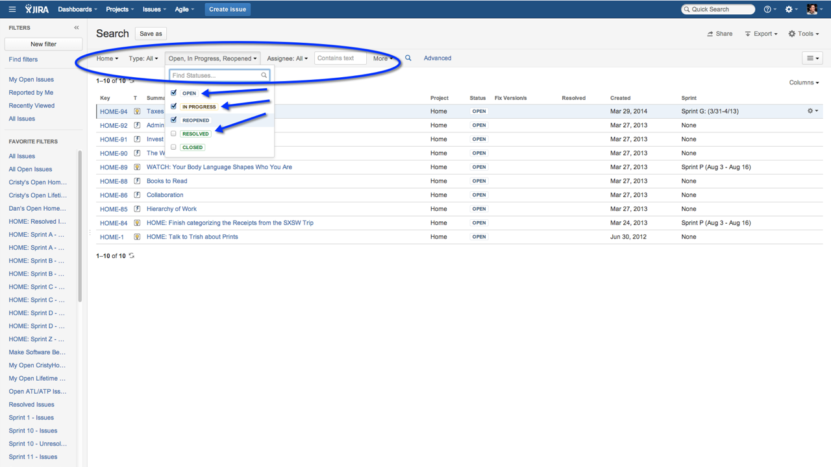


Slide 35
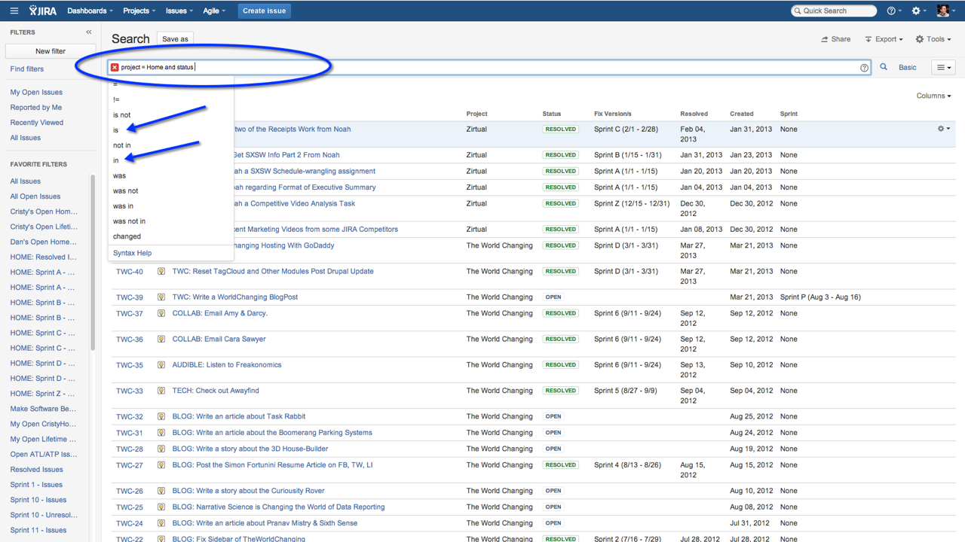

Slide 36
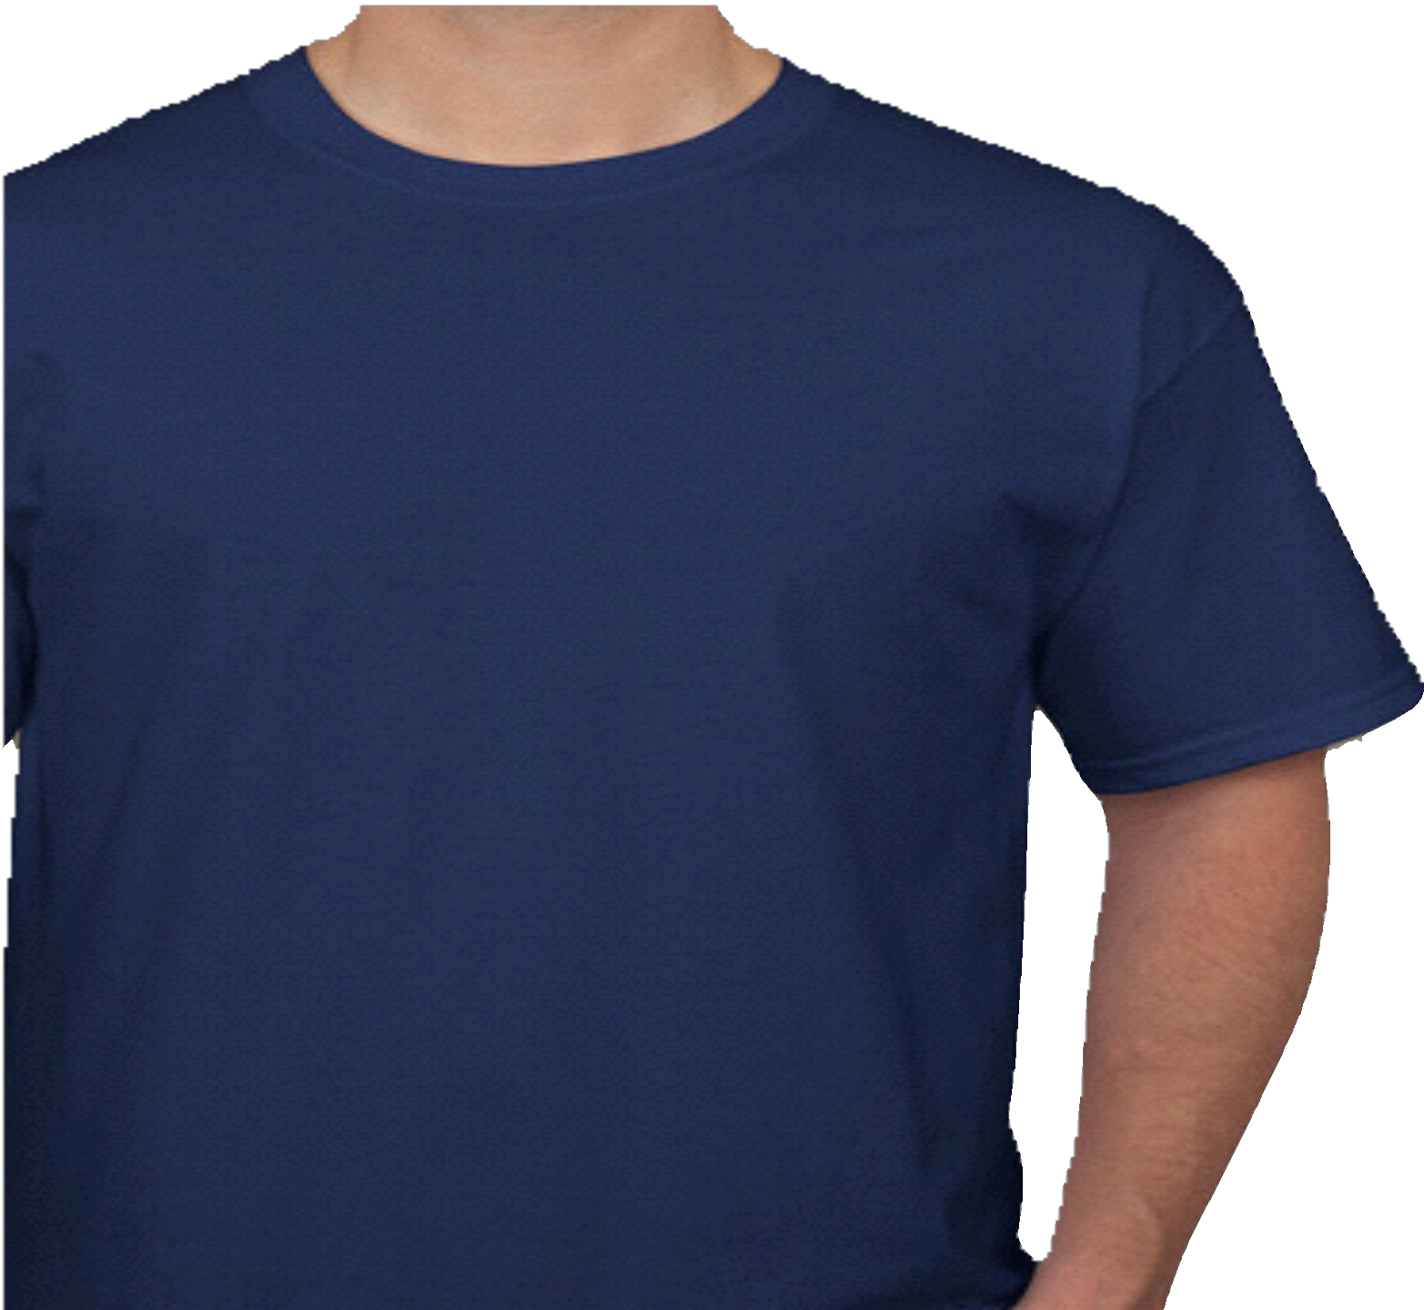
Thanks!
Questions

